Slide 1



DETERMINATION OF NOISE POLLUTION RISK POINTS USING GIS TECHNIQUES Mr. Damrongsak chatkul Mr. Thanawat preechachot Mr. Somchai chumsai KISTI IOT DATA HACKATHON Nov. 16 – 22, 2017 SAINT HOUSE, JEJU

Slide 2
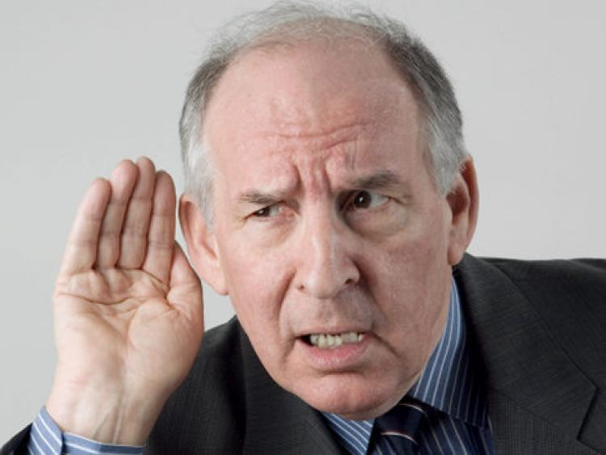
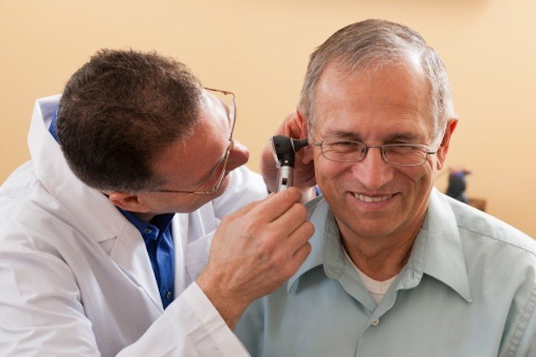
Introduction
เพิ่มภาพประกอบ
http://assets.nydailynews.com
http://kgab.com
อันตรายต่อระบบการได้ยิน
ประสิทธิภาพการทำงานลดลง
เสียค่าใช้จ่ายในการควบคุม
So, it is very important to …… the risk points
Notes:
One of the most problems commonly found in urban areas is noise pollution. The noise pollution has many effects to human life. For examples,
hearing to too loud noise for a long time can damage human hearing system. Moreover, working efficient can be decreased in noisy environment.
so, we want to use the provided data to find the risk points using geographic information systems (GIS) techniques.

Slide 3
Objectives
1. To visualize noise pollution level
2. To analyze noise pollution risk points using GIS techniques

Slide 4



Tools and data
PostGIS
แปะรูปไอคอน หรือตัวอย่างหน้าจอแต่ละโปรแกรม
1. Software
1.1 PostGIS, SQLyog Community
1.2 GIS software : QGIS
2. Data
2.1 date and time (timestamp)
2.2 latitude and longitude (lat, lng)
2.3 noise level (mcp_value)
SQLyog Community
GIS software

Slide 5
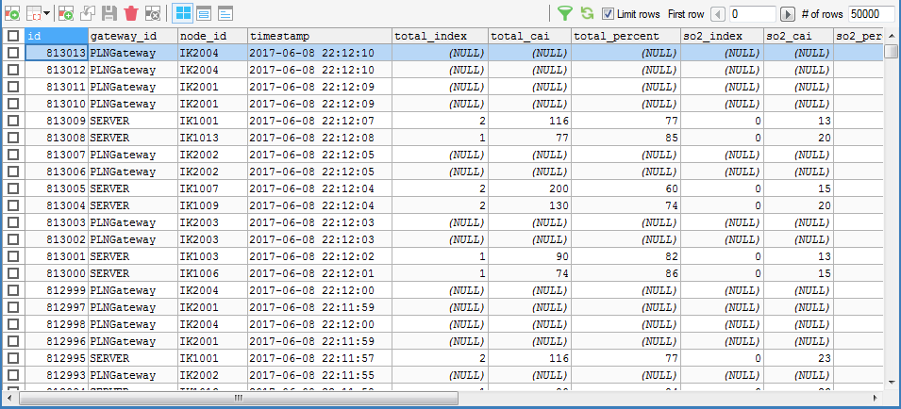
Methodology
6,569 data points
34 cars
Extract and convert data (lat, lng, pcm_value, …) to CSV
ภาพ sql หรือ หน้าต่าง sqlyog
4,253,003 Million data points
Notes:
1. We downloaded data from KISTI server and saved them as CSV files. The data dated from 1st October to 17th November, 2017. There were 34 cars and there were around 6,000 data-points/car. So, we collected around 4 millions data points.

Slide 6
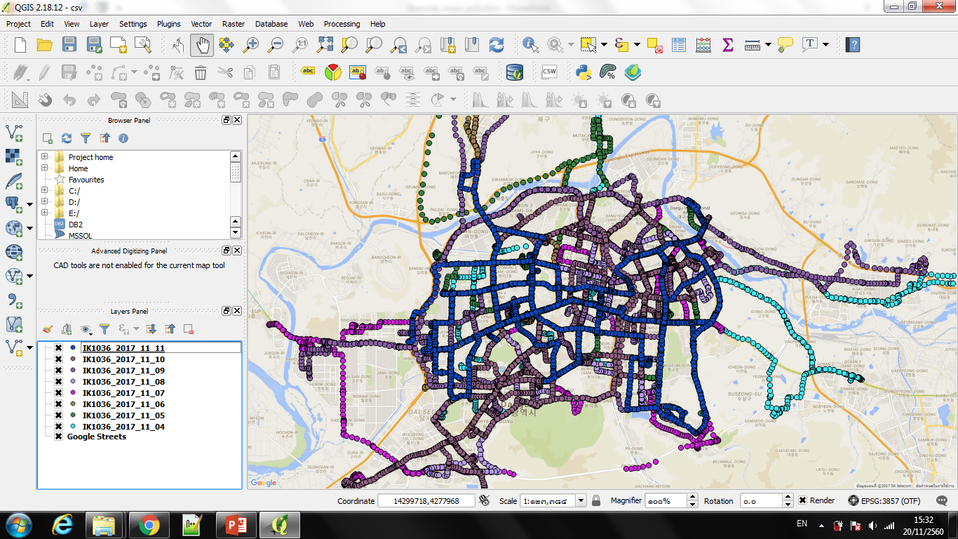
Methodology
ภาพก่อนและหลังการ merge
Notes:
2. Next, we imported the CSV files into QGIS software, merged all CSV files and then saved the data as a shapefile. This was the screenshot of QGIS.

Slide 7
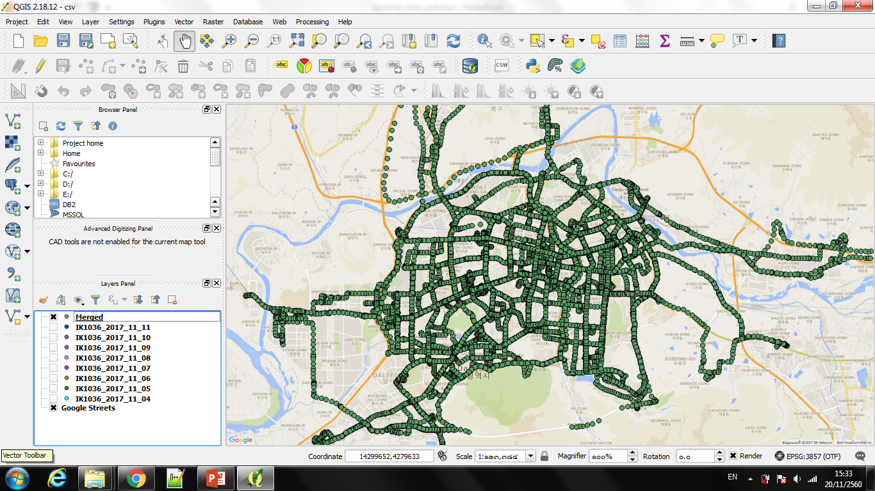
Methodology
Notes:
- Here’s the data after merging. All points were shown in green.

Slide 8
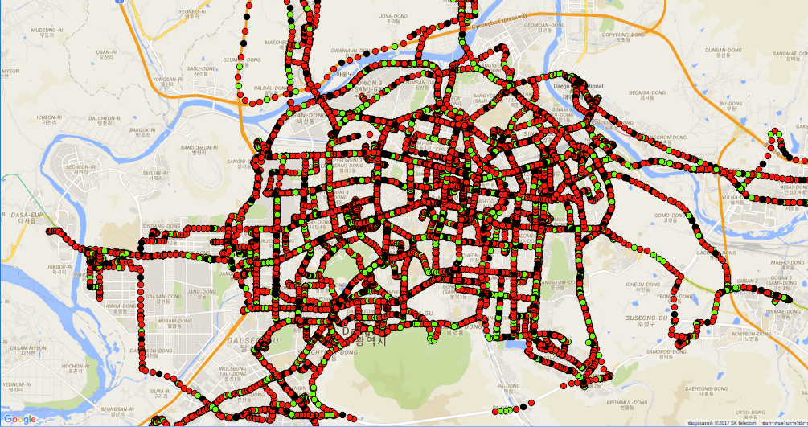
Methodology (cont’d)
< 20 dB
20 – 40 dB
40 – 60 dB
60 – 80 dB
> 85 dB
Risk Point ที่ต้องการ
100 – 250 Values
Notes:
- Next, we classified the data-points into 5 classes as shown on the screen. Here, any point with the noise level above 85 decibel will be classified as a risk point.

Slide 9
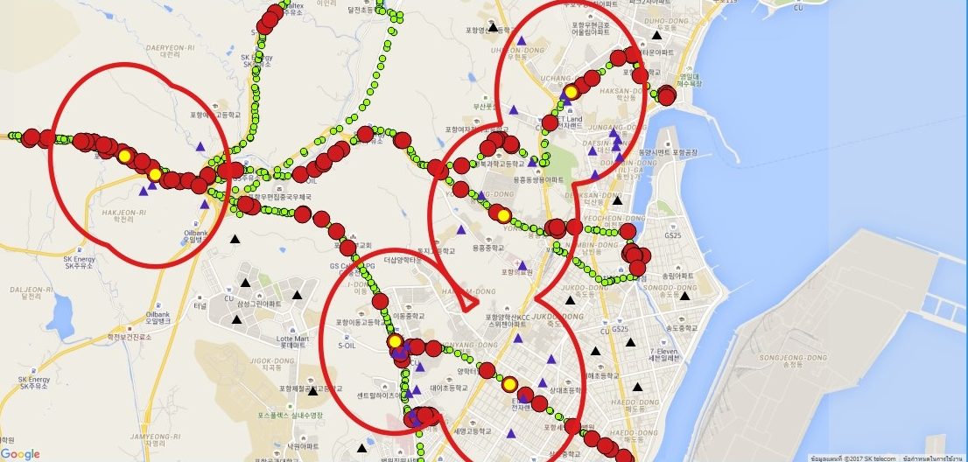
5
6
4
1
2
3
Notes:
Here, the yellow points were the highest risk points while the red and green points had lower noise levels.
Given the yellow risk points, we calculated buffer around each risk-points using the fixed distance buffer algorithm in QGIS. The distance for creating the buffer was set to 50m as shown as the red polygons in the figure.
In order to demonstrate the application. We drew around 1000 dummy building points in Google Earth and imported them into QGIS.
1) Here, we showed houses with in the risk areas as blue triangles
2) These were the buffers around the risk points. We used them as risk areas
3) The yellow points were the risk points
4) These red points were data-points that had around 80db. In this workshop, we didn’t classified them as risk points.
5) These data-points were low risk points
6) This black triangle was an example of a building outside the risk areas, the low risk zones.

Slide 10
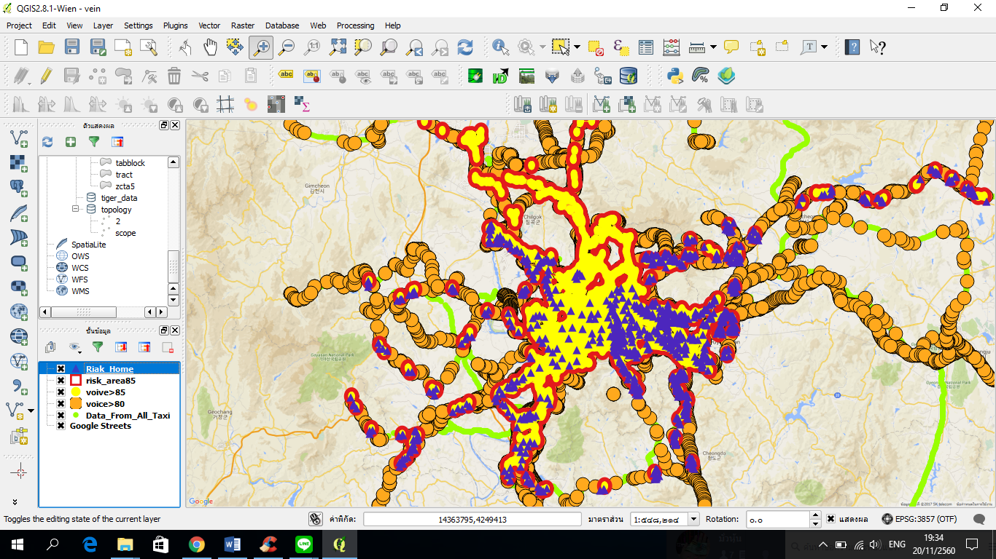
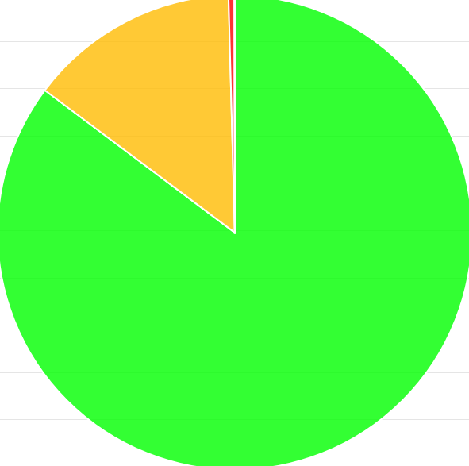
16,741 data points
1,218 data points
4,253,003 data points
Notes:
This was our result.
From 4 million points, we found 1,218 points with high risk levels which was less than 1%. There were around 16,741 points with 80db which was around 0.4%. The others 4,253,003 points were classified as low risk points which was around 99%.

Slide 11
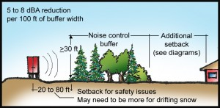
Discussion
http://arbordayblog.org.com
Notes:
Once we found the risk areas, there were several solutions to do. For example, we could plant trees as noise control buffers to reduce noise level. And because we had locations of the risk areas, we could know exactly where and how many trees to be planted.

Slide 12
Thank you

